Slide 1

Music Recommendation Service
Group 2: Jason Ingram & Isaiah Martinez
Notes:
1. Table of contents
2. Introduction
3. Quote
4. Study objectives
5. Literature review
6. Schedule
7. Methodology
8. Table
9. Results analysis
10. Conclusions
11. Bibliographical references

Slide 2
Table of contents
01
03
02
04
Project
Design
Data
Cleaning
Data
Visualization
Data
Selection

Slide 3
01
Project Design

Slide 4

Project Description
Music Recommendation Service:
1 Source for Music
and User Data
Source for Data

Slide 5
Project Design
Music Recommender
Combined
Music and User Data

Slide 6


Why did we change the dataset used?
Not easily usable:
Required manual cleaning or advanced automation techniques
Over 40,000 malformed entries out of a total 200,000 entries (~20%)
No relational data for the songs
Blacklisted from Last.fm and All Music

Slide 7
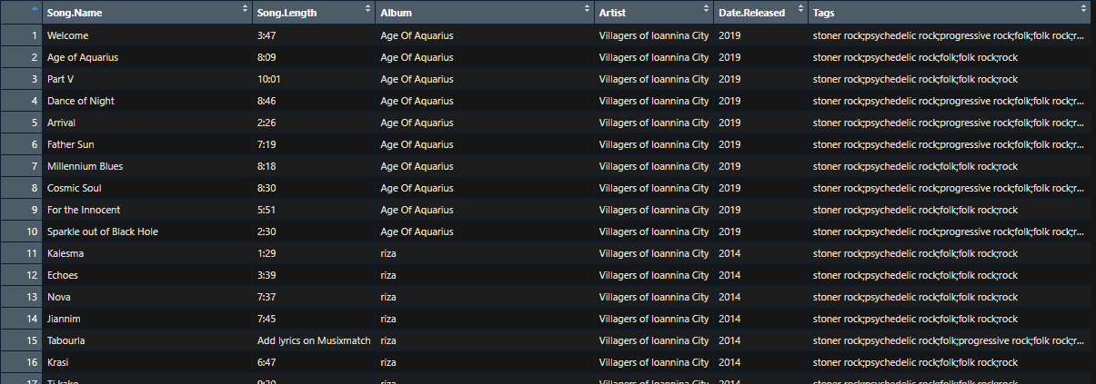
Previous data
Post-Cleaning for previous data

Slide 8
02
Data Visualization

Slide 9
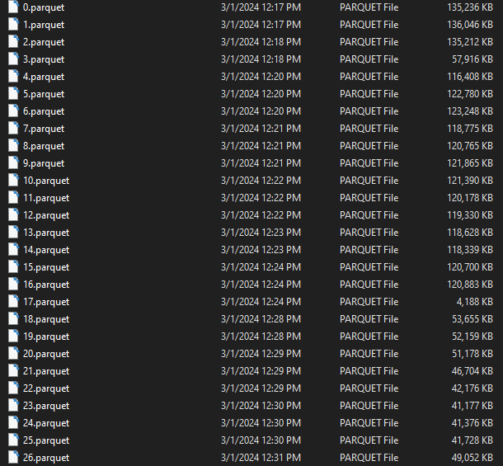
Data Files
Located in parquet Files from MusicBrainz
Total of 789 parquet files with size of ~42GB
First parquet has over 1 million entries
Some of the parquet files downloaded

Slide 10

Reading the Data
Requires package to extract information (Arrow)
10 attributes:
release_name (Album Name)
recording_name (Song Name)
recording_mbid (used for server-side data processing
release_mbid (unique album id)
recording_msid (song id)
artist_credit_id (artist id)
artist_credit_mbids (server-side artists credited)
listened_at (YYYY-MM-DD HH:MM:SS)
user_id
artist_name
Package to install in R

Slide 11
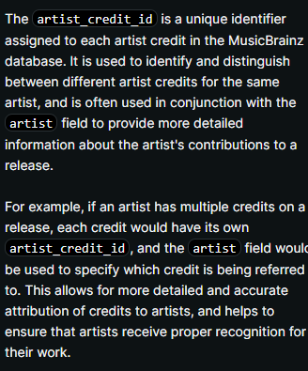
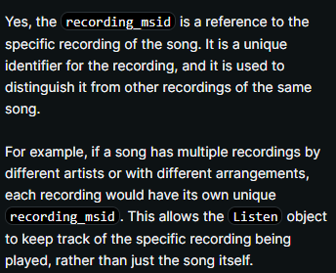
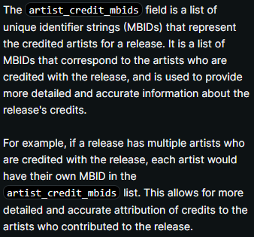
Attributes In-Depth

Slide 12
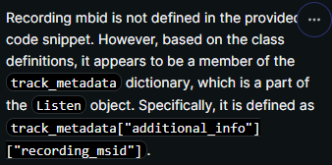
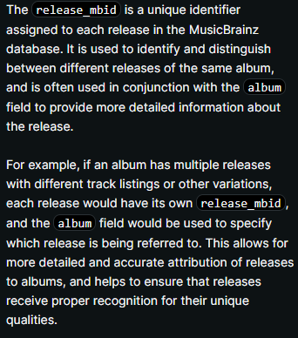
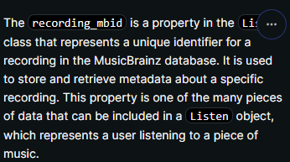
Attributes In-Depth

Slide 13
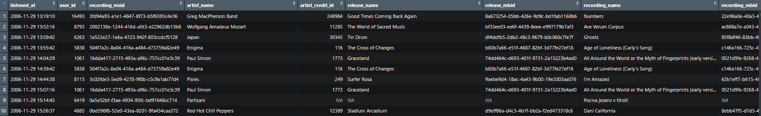
Data Visualization
Initial View of Data

Slide 14
> 60,000
Total listens within parquet file 17

Slide 15
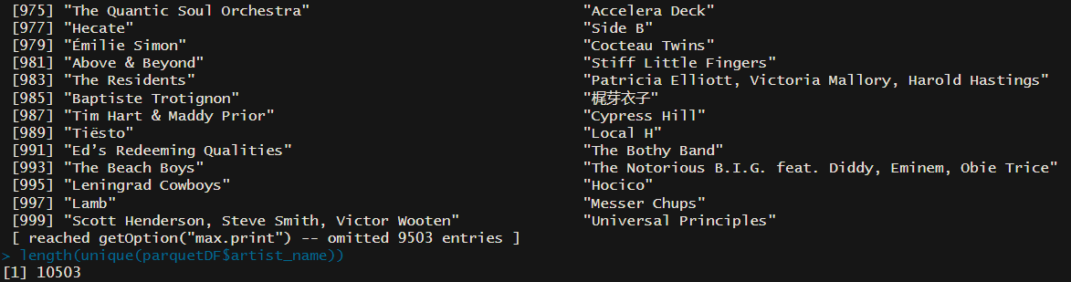
Unique Artists
Over 10,000 artists obtained

Slide 16
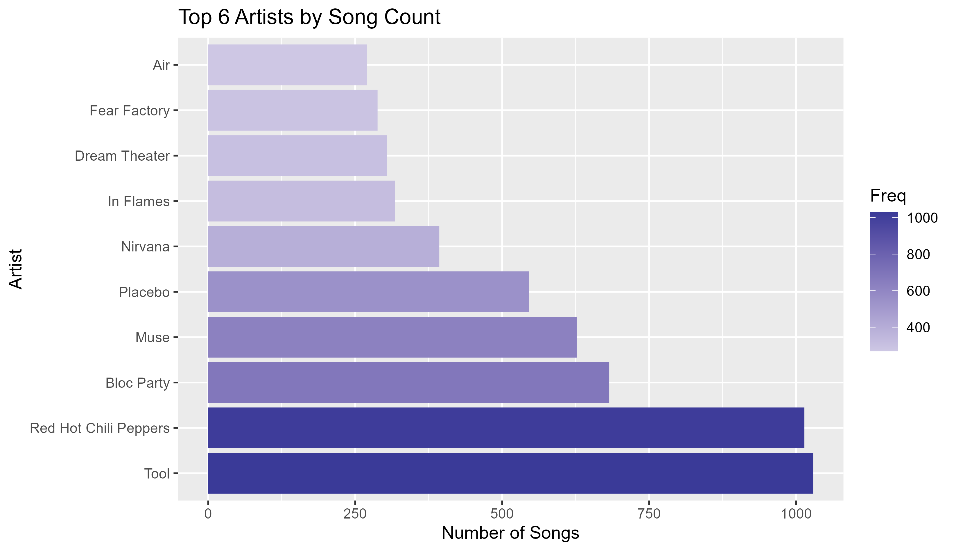
Top Artists by Listens

Slide 17
03
Data Cleaning

Slide 18
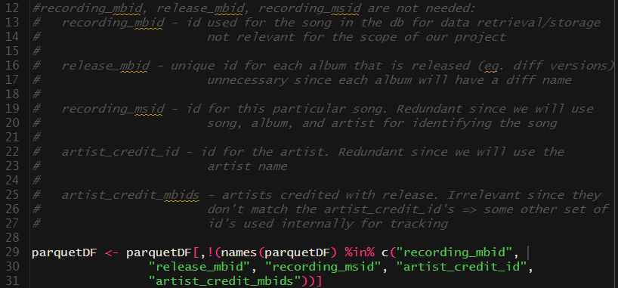
Irrelevant Attributes
Removal of attributes

Slide 19
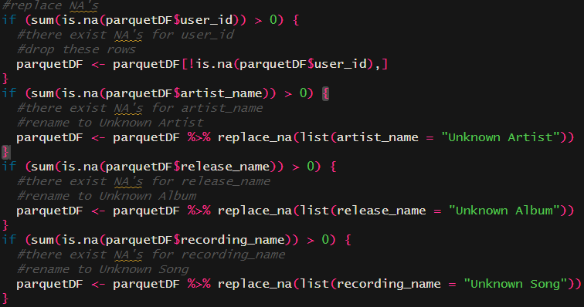
Missing/NA Values
Replace Missing Artists with “Unknown Artist”
Replace Missing Album with “Unknown Album”
Replace Missing Song Name with “Unknown Song”

Slide 20
04
Data Selection

Slide 21
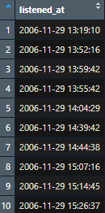
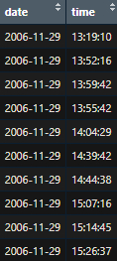
Feature Engineering
Split `listened_at` into 2 different columns: `date` and `time`
Before
After

Slide 22
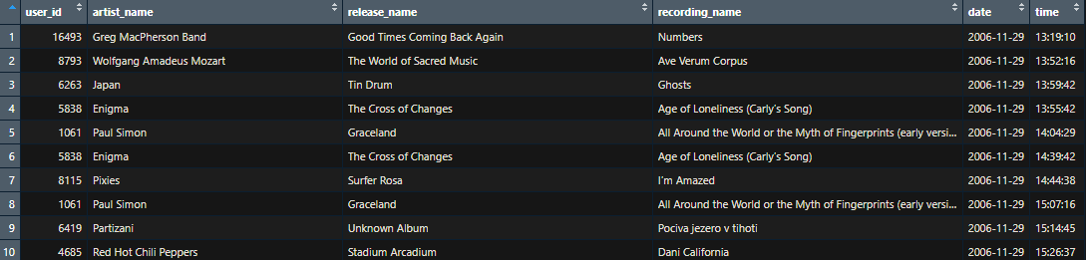
Final Dataset

Slide 23

Questions?
Thanks for Listening

